Slide 1
ME759 High Performance Computing for Applications in Engineering [Spring 2021]
Lecture 25
03/22/2021
Dan Negrut, 2021 ME759 UW-Madison

Slide 2
Quote of the day
“The happiness of your life depends upon the quality of your thoughts. Therefore, guard accordingly, and take care that you entertain no notions unsuitable to virtue and reasonable nature.”
-- Marcus Aurelius, Roman Emperor 161 to 180 CE

Slide 3
Quote of the day, same dude
“Never let the future disturb you. You will meet it, if you have to, with the same weapons of reason which today arm you against the present.”
-- Marcus Aurelius, Roman Emperor 161 to 180 CE

Slide 4
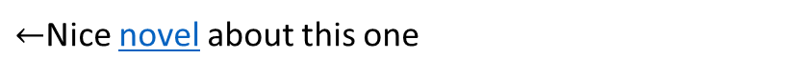
Some Roman Emperors
Trajan (98–117 CE)
Hadrian (117–138 CE)
Antoninus Pius (138–161 CE)
Marcus Aurelius (161–180 CE)
$←$Nice piece of Engineering, bridge across Danube
$←$Nice novel about this one
$←$Nice thinking, this one

Slide 5
Is BBC recording on?
If my internet connection goes down, I’ll email from my phone to provide more information – go/no-go, next step, etc.

Slide 6
Before we get started…
Last time
Critical thinking, and similar tricks for speeding up your code
Know your hardware; help the compiler help you; optimization blockers: function calls and use of pointers
Today
Wrapping up, “Critical thinking” segment
Case study
Other tidbits:
Assignment due on Th, 03/25, at 9 pm
Final Project *Proposal*, due tonight at 9 pm. Post related questions on Piazza
Details about the proposal are here
The template for the two-page proposal is here
Big ME759 PDF is here
Do not run your code on the Euler head-node (use Slurm)

Slide 7
New Example, with three actors: one struct + two functions
len
0
1
len-1
Our struct will use various Data Types
Use different declarations for data_t:
int
long
float
double
data
/* data structure for vectors */
typedef struct {
size_t len;
data_t *data;
} vec;
This is “the” struct that comes into play
/* retrieve vector element and store in val */
void get_vec_element(vec* v, size_t idx, data_t *val) {
if (idx < 0 || idx >= v->len)
*val = 0;
else
*val = v->data[idx];
}
The first function that comes into play
[15-213 @ CMU]$→$

Slide 8

Wrapping up the setup, for the new example
void combine1(vec_ptr v, data_t *dest) {
*dest = IDENT; // the identity value for OP
for (int i = 0; i < vec_length(v); i++) {
data_t val;
get_vec_element(v, i, &val);
*dest = *dest OP val;
}
}
Compute sum or product of vector elements (based on OP)
The second function that comes into play
Data Types
Use different declarations for data_t
int
long
float
double
Operations (OP)
Use different definitions of OP and IDENT
“+” : 0
“*” : 1
[15-213 @ CMU]$→$

Slide 9
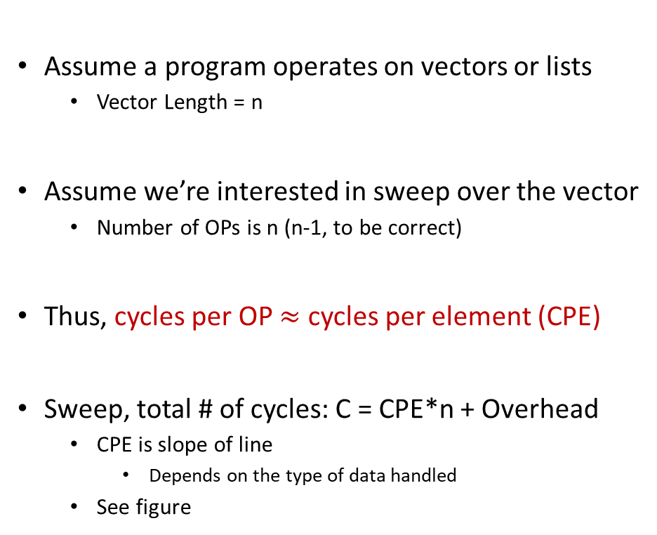
Cycles Per Element (CPE)
Assume a program operates on vectors or lists
Vector Length = n
Assume we’re interested in sweep over the vector
Number of OPs is n (n-1, to be correct)
Thus, cycles per OP $≈$ cycles per element (CPE)
Sweep, total # of cycles: C = CPE*n + Overhead
CPE is slope of line
Depends on the type of data handled
See figure
psum1
Slope = 9.0
(double prec.)
psum2
Slope = 6.0
(int)
[15-213 @ CMU]$→$
Notes:
CPE – amount of average effort, per element, to see the sweep through

Slide 10
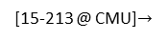
Benchmark Performance
void combine1(vec_ptr v, data_t *dest) {
*dest = IDENT; // the identity value for OP
for (int i = 0; i < vec_length(v); i++) {
data_t val;
get_vec_element(v, i, &val);
*dest = *dest OP val;
}
}
Sweep to compute sum or product of vector elements
!
Results in CPE (cycles per element) – Smaller is BETTER!
Method | data_t: Integer |  | data_t:Double FP
Operation (OP) | add | mult | add | mult
combine1 unoptimized | 22.68 | 20.02 | 19.98 | 20.18
combine1 with –O1 | 10.12 | 10.12 | 10.17 | 11.14
combine1 with –O3 | 4.5 | 4.5 | 6 | 7.8
[15-213 @ CMU]$→$

Slide 11
Basic Optimizations
No function call here anymore
void combine4(vec_ptr v, data_t *dest) {
int length = vec_length(v);
data_t *d = get_vec_start(v);
data_t temp = IDENT;
for (int i = 0; i < length; i++)
temp = temp OP d[i];
*dest = temp;
}
Shortcut: you get the raw pointer, and index into it… No need to call get_vec_element
Modification #1: vec_length moved out of loop
One function call avoided at each iteration
Modification #2: bypassed get_vec_element call
Modification #3: Accumulate in temporary “temp”
[15-213 @ CMU]$→$

Slide 12
Effect of Basic Optimizations
void combine4(vec_ptr v, data_t *dest) {
int length = vec_length(v);
data_t *d = get_vec_start(v);
data_t temp = IDENT;
for (int i = 0; i < length; i++)
temp = temp OP d[i];
*dest = temp;
}
Method | Integer |  | Double FP
Operation | add | mult | add | mult
combine1 –O1 | 10.12 | 10.12 | 10.17 | 11.14
combine4 | 1.27 | 3.01 | 3.01 | 5.01
Eliminates overhead in for loop & it can do prefetching
[15-213 @ CMU]$→$

Slide 13
Opportunities for Efficiency Gains
Cluster (distributed mem.)
Group of nodes communicate through fast interconnect
MPI, Charm++, Chapel
Multi-Socket Node
Group of CPUs on the same node, talk through main mem.
OpenMP, MPI
Acceleration (GPU/Phi)
Compute devices accelerating parallel computation on one node
CUDA, OpenCL, OpenMP
Multi-Core Processor
Communication through shared caches and main mem.
OpenMP, TBB, pthreads
Vectorization
Higher operation throughput via special/fat registers
AVX, SSE
Pipelining
Sequence of instruction sharing functional units
Assembly
Superscalar
Non-sequence instructions sharing functional units
Assembly
We have full control →
We have little to no control →
Little, but might pack a punch!

Slide 14
[Next thing to consider:] Exploiting Instruction-Level Parallelism
Simple ILP-targeted transformations can yield good performance improvements
Compilers often cannot make these transformations since they don’t know if it’s safe to do so or not
ILP
Hardware can execute multiple instructions in parallel
Performance limited by ILP hazards

Slide 15
Curbing our enthusiasm, ILP hazards
Structural hazards
The scheduler: “Unfortunately, there aren’t enough hammers in this plant”
Data dependency hazards
The scheduler: “This next instruction depends on the outcome of the instruction right ahead of it”
Control hazards
The scheduler: “I’m not sure what is supposed to happen next”

Slide 16
Modern CPU Design [old slide]
Instruction Control
Fetch
Control
Address
Instruction
Cache
Retirement
Unit
Register
File
Instruction
Decode
Instructions
Operations
Register Updates
Prediction OK?
Execution
Functional
Units
Branch
Arith
Arith
Arith
Load
Store
Operation Results
Addr.
Addr.
Data
Data
Data
Cache
[15-213 @ CMU]$→$

Slide 17
Recall ILP discussion, 1.5 months ago: superscalar attribute
Superscalar processor: one that can issue more than one instruction in one cycle. The instructions are retrieved from a sequential instruction stream and are usually scheduled dynamically
Superscalar processor: one manifestation of the instruction level parallelism idea
Note: Most modern CPUs are superscalar
Intel: since Pentium (1993)
[15-213 @ CMU]$→$

Slide 18
Old ILP discussion: the pipelining attribute
Stage 1
int mult_example(int a, int b, int c) {
int p1 = a * b;
int p2 = a * c;
int p3 = p1 * p2;
return p3;
}
Stage 2
Stage 3
 | Time
 | 1 | 2 | 3 | 4 | 5 | 6 | 7
Stage 1 | a*b | a*c |  |  | p1*p2
Stage 2 |  | a*b | a*c |  |  | p1*p2
Stage 3 |  |  | a*b | a*c |  |  | p1*p2
Divide computation into stages
Pass partial computations from stage to stage
Stage s can start on new computation once values passed to s+1
E.g., complete 3 multiplications in 7 cycles, even though each requires 3 cycles
Note when p1*p2 is issued – classical data dependency situation

Slide 19
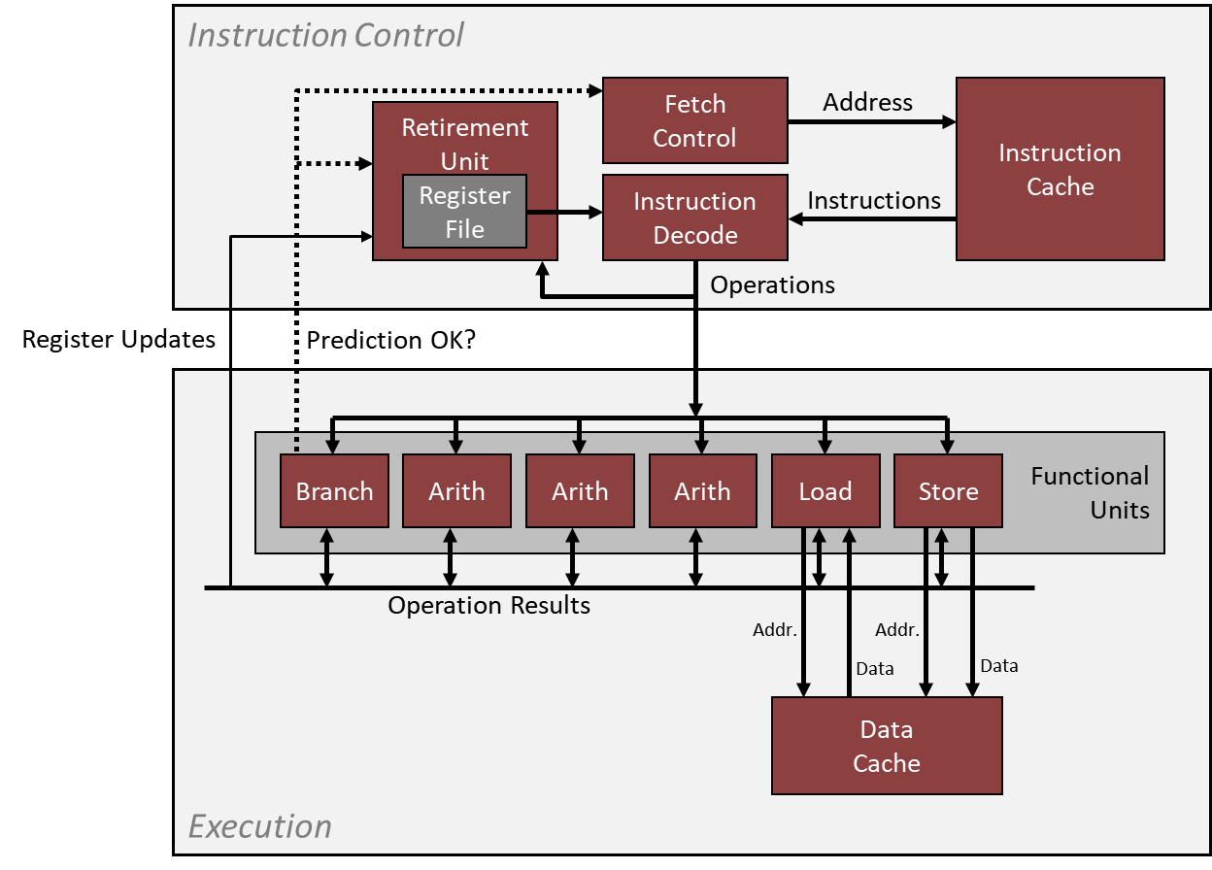
Example: The Intel Haswell CPU – aspects that are ILP relevant
Haswell: 8 Total Functional Units
Multiple instructions can execute in parallel
2 load, with address computation
1 store, with address computation
4 integer ops (doing address arithmetic too – explains why you have more)
2 FP multiply
1 FP add
1 FP divide
Some instructions take > 1 cycle, but can be pipelined
Instruction Its Latency (in cycles) Its Issue (in cycles)
Load / Store 4 1
Integer Add 1 1
Integer Multiply 3 1
Integer/Long Divide 3-30 3-30
Single/Double FP Add 3 1
Single/Double FP Multiply 5 1
Single/Double FP Divide 3-15 3-15
For this type of info: see Agner Fog's optimization manual (part of “ME759 assigned reading” list)
[15-213 @ CMU]$→$

Slide 20
x86-64 Compilation of combine4 function
Inner Loop (Case: Integer Multiply)
.L519: # Loop:
imull (%rax,%rdx,4), %ecx # t = t * d[i]
addq $1, %rdx # i++
cmpq %rdx, %rbp # Compare length:i
jg .L519 # If >, goto Loop
Method | Integer |  | Double FP
Operation | add | mult | add | mult
combine4 | 1.27 | 3.01 | 3.01 | 5.01
Latency Bound | 1.00 | 3.00 | 3.00 | 5.00
[15-213 @ CMU]$→$

Slide 21

combine4 = Serial Computation
Assume OP $≡$ multiplication ($∗$)
1
d₀
Computation, assume length=8:
((((((((1 * d[0]) * d[1]) * d[2]) * d[3]) * d[4]) * d[5]) * d[6]) * d[7])
You have sequential dependence
Performance: determined by latency of OP
*
d₁
*
d₂
*
d₃
*
d₄
*
d₅
*
d₆
*
d₇
*
[15-213 @ CMU]$→$

Slide 22
First trick: Loop Unrolling (2x1)
void unroll2a_combine(vec_ptr v, data_t *dest) {
int length = vec_length(v);
int limit = length - 1;
data_t *d = get_vec_start(v);
data_t x = IDENT;
int i;
// Combine 2 elements at a time
for (i = 0; i < limit; i += 2) {
x = (x OP d[i]) OP d[i + 1];
}
// Finish any remaining elements
for (; i < length; i++) {
x = x OP d[i];
}
*dest = x;
}
Perform 2x more useful work per iteration
[15-213 @ CMU]$→$

Slide 23
Effect of Loop Unrolling
Method | Integer |  | Double FP
Operation | add | mult | add | mult
combine4 | 1.27 | 3.01 | 3.01 | 5.01
unroll2a | 1.01 | 3.01 | 3.01 | 5.01
Latency Bound | 1.00 | 3.00 | 3.00 | 5.00
Helps integer add
Achieves latency bound
Others don’t improve. Why?
Still sequential dependency
x = (x OP d[i]) OP d[i+1];
[15-213 @ CMU]$→$

Slide 24
Loop Unrolling with Reassociation (2x1a)
void unroll2aa_combine(vec_ptr v, data_t *dest) {
int length = vec_length(v);
int limit = length - 1;
data_t *d = get_vec_start(v);
data_t x = IDENT;
int i;
/* Combine 2 elements at a time */
for (i = 0; i < limit; i += 2) {
x = x OP(d[i] OP d[i + 1]);
}
/* Finish any remaining elements */
for (; i < length; i++) {
x = x OP d[i];
}
*dest = x;
}
Compare to before
x = (x OP d[i]) OP d[i+1];
Can this change the result of the computation?
Yes, for FP. Why?
[15-213 @ CMU]$→$

Slide 25
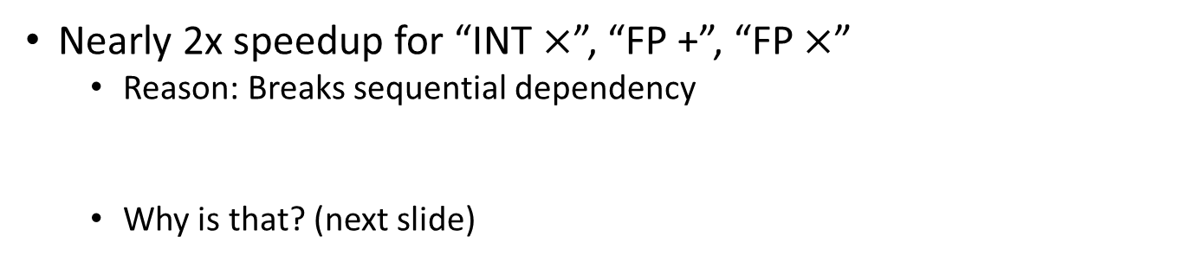
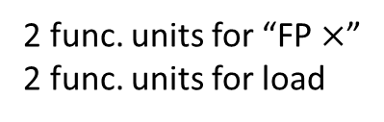
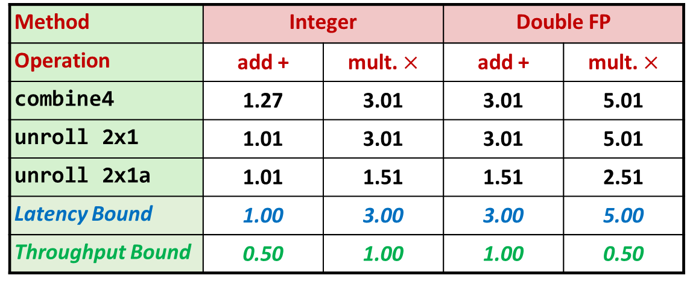
Effect of Reassociation
Method | Integer |  | Double FP
Operation | add + | mult. $×$ | add + | mult. $×$
combine4 | 1.27 | 3.01 | 3.01 | 5.01
unroll 2x1 | 1.01 | 3.01 | 3.01 | 5.01
unroll 2x1a | 1.01 | 1.51 | 1.51 | 2.51
Latency Bound | 1.00 | 3.00 | 3.00 | 5.00
Throughput Bound | 0.50 | 1.00 | 1.00 | 0.50
4 func. units for “INT +”
2 func. units for load
2 func. units for “FP $×$”
2 func. units for load
Nearly 2x speedup for “INT $×$”, “FP +”, “FP $×$”
Reason: Breaks sequential dependency
Why is that? (next slide)
x = x OP (d[i] OP d[i+1]);
[15-213 @ CMU]$→$

Slide 26
Reassociated Computation
x = x OP (d[i] OP d[i+1]);
What changed:
Ops in the next iteration can be started early (no dependency)
Prefetching kicks in
Overall Performance
N elements, D cycles latency/op
(N/2+1)*D cycles: CPE = D/2
d₀
d₁
*
d₂
d₃
1
*
d₄
d₅
*
*
d₆
d₇
*
*
*
*
[15-213 @ CMU]$→$

Slide 27
Loop Unrolling with Separate Accumulators (2x2)
void unroll2a_combine(vec_ptr v, data_t *dest) {
long length = vec_length(v);
long limit = length - 1;
data_t *d = get_vec_start(v);
data_t x0 = IDENT;
data_t x1 = IDENT;
long i;
// Combine 2 elements at a time
for (i = 0; i < limit; i += 2) {
x0 = x0 OP d[i];
x1 = x1 OP d[i + 1];
}
// Finish any remaining elements
for (; i < length; i++) {
x0 = x0 OP d[i];
}
*dest = x0 OP x1;
}
Different form of reassociation
[15-213 @ CMU]$→$

Slide 28
Effect of Separate Accumulators
Method | Integer |  | Double FP
Operation | Add | Mult | Add | Mult
Combine4 | 1.27 | 3.01 | 3.01 | 5.01
Unroll 2x1 | 1.01 | 3.01 | 3.01 | 5.01
Unroll 2x1a | 1.01 | 1.51 | 1.51 | 2.51
Unroll 2x2 | 0.81 | 1.51 | 1.51 | 2.51
Latency Bound | 1.00 | 3.00 | 3.00 | 5.00
Throughput Bound | 0.50 | 1.00 | 1.00 | 0.50
“INT +” makes use of two load units
2x speedup (over unroll2) for “INT *”, “FP +”, “FP *”
x0 = x0 OP d[i];
x1 = x1 OP d[i+1];
[15-213 @ CMU]$→$

Slide 29
Separate Accumulators
x0 = x0 OP d[i];
x1 = x1 OP d[i+1];
What changed:
Two independent “streams” of operations
Overall Performance
N elements, D cycles latency/op
Should be (N/2+1)*D cycles: CPE = D/2
CPE matches prediction!
1
d₀
1
d₁
*
d₂
*
d₃
*
d₄
*
d₅
*
d₆
*
d₇
*
*
What Now?
*
[15-213 @ CMU]$→$

Slide 30
Unrolling & Accumulating
Idea
Can unroll to any degree L
Can accumulate K results in parallel
L must be multiple of K
Limitations
Diminishing returns
Cannot go beyond throughput limitations of execution units
Large overhead for short lengths
Finish off iterations sequentially
[15-213 @ CMU]$→$

Slide 31
Unrolling & Accumulating: Floating Point Multiplication
Case
Intel Haswell
Double FP Multiplication
Latency bound: 5.00. Throughput bound: 0.50
FP * | Unrolling Factor L
K | 1 | 2 | 3 | 4 | 6 | 8 | 10 | 12
1 | 5.01 | 5.01 | 5.01 | 5.01 | 5.01 | 5.01 | 5.01
2 |  | 2.51 |  | 2.51 |  | 2.51
3 |  |  | 1.67
4 |  |  |  | 1.25 |  | 1.26
6 |  |  |  |  | 0.84 |  |  | 0.88
8 |  |  |  |  |  | 0.63
10 |  |  |  |  |  |  | 0.51
12 |  |  |  |  |  |  |  | 0.52
Accumulators
[15-213 @ CMU]$→$

Slide 32
Unrolling & Accumulating: Integer Addition
Case
Intel Haswell
Integer addition
Latency bound: 1.00. Throughput bound: 0.50
FP * | Unrolling Factor L
K | 1 | 2 | 3 | 4 | 6 | 8 | 10 | 12
1 | 1.27 | 1.01 | 1.01 | 1.01 | 1.01 | 1.01 | 1.01
2 |  | 0.81 |  | 0.69 |  | 0.54
3 |  |  | 0.74
4 |  |  |  | 0.69 |  | 1.24
6 |  |  |  |  | 0.56 |  |  | 0.56
8 |  |  |  |  |  | 0.54
10 |  |  |  |  |  |  | 0.54
12 |  |  |  |  |  |  |  | 0.56
Accumulators
[15-213 @ CMU]$→$

Slide 33
Achievable Performance
Method | Integer |  | Double FP
Operation | Add | Mult | Add | Mult
Best | 0.54 | 1.01 | 1.01 | 0.52
Latency Bound | 1.00 | 3.00 | 3.00 | 5.00
Throughput Bound | 0.50 | 1.00 | 1.00 | 0.50
Limited only by throughput of functional units
Up to 42X improvement over original, un-optimized code
[15-213 @ CMU]$→$

Slide 34
Vector instructions
Basic idea: Use fat registers to perform the same operation on all variables stored in register
X86 has, for instance, 512 bit-wide registers
Technology called AVX512
Since chip in this example is Haswell, it only has 256-bit registers
Technology called AVX2

Slide 35
Programming with AVX2, YMM Registers related
16 such registers, each 32 bytes (i.e., 256 bits wide)
What can you do with them?
Store 8 32-bit integers:
Store 8 single-precision floats:
Store 4 double-precision floats:
Store 1 single-precision float but then waste bits:
Store 1 double-precision float but then waste bits:

Slide 36
SIMD Operations, with AVX2
SIMD Operations: Single Precision
SIMD Operations: Double Precision
vaddsd %ymm0, %ymm1, %ymm1
%ymm0
+
+
+
+
+
+
+
+
%ymm1
vaddpd %ymm0, %ymm1, %ymm1
%ymm0
+
+
+
+
%ymm1
[15-213 @ CMU]$→$

Slide 37
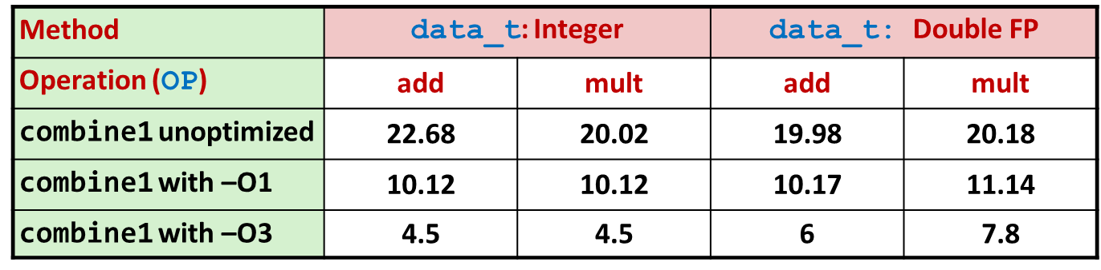
Using Vector Instructions
Method | Integer |  | Double FP
Operation | add | mult | add | mult
Scalar Best | 0.54 | 1.01 | 1.01 | 0.52
Vector Best | 0.06 | 0.24 | 0.25 | 0.16
Latency Bound | 0.50 | 3.00 | 3.00 | 5.00
Throughput Bound | 0.50 | 1.00 | 1.00 | 0.50
Vec Throughput Bound | 0.06 | 0.12 | 0.25 | 0.12
This is where we are now
Additional speedup owing to use of AVX Instructions
Parallel operations on multiple data elements
The “mips” in OpenMP
CPE: From 22.68 to 0.06: 378X speed increase
This is where we started
[15-213 @ CMU]$→$

Slide 38
Supplemental Material: Branch Prediction (another ILP trick)
Challenge
Instruction Control Unit must work ahead of Execution Unit to generate enough operations to keep EU busy
When encounters conditional branch, cannot reliably determine where to continue fetching
404663: mov $0x0,%eax
404668: cmp (%rdi),%rsi
40466b: jge 404685
40466d: mov 0x8(%rdi),%rax
. . .
404685: repz retq
Executing
How to continue?
[15-213 @ CMU]$→$

Slide 39
Modern CPU Design
Instruction Control
Fetch
Control
Address
Instruction
Cache
Retirement
Unit
Register
File
Instruction
Decode
Instructions
Operations
Register Updates
Prediction OK?
Execution
Functional
Units
Branch
Arith
Arith
Arith
Load
Store
Operation Results
Addr.
Addr.
Data
Data
Data
Cache
[15-213 @ CMU]$→$

Slide 40
Branch Outcomes
When encounter conditional branch, cannot determine where to continue fetching
Branch Taken: Transfer control to branch target
Branch Not-Taken: Continue with next instruction in sequence
Cannot resolve until outcome determined by branch/integer unit
404663: mov $0x0,%eax
404668: cmp (%rdi),%rsi
40466b: jge 404685
40466d: mov 0x8(%rdi),%rax
. . .
404685: repz retq
Branch Not-Taken
Branch Taken
[15-213 @ CMU]$→$

Slide 41
Branch Prediction
Idea
Guess which way branch will go
Begin executing instructions at predicted position
But don’t actually modify register or memory data (draws on RAT & ROB, see later)
404663: mov $0x0,%eax
404668: cmp (%rdi),%rsi
40466b: jge 404685
40466d: mov 0x8(%rdi),%rax
. . .
404685: repz retq
Predict Taken
Begin
Execution
[15-213 @ CMU]$→$

Slide 42
Branch Prediction Through Loop
401029: vmulsd (%rdx),%xmm0,%xmm0
40102d: add $0x8,%rdx
401031: cmp %rax,%rdx
401034: jne 401029
Assume
vector length = 100
i = 98
Predict Taken (OK)
401029: vmulsd (%rdx),%xmm0,%xmm0
40102d: add $0x8,%rdx
401031: cmp %rax,%rdx
401034: jne 401029
i = 99
Predict Taken
(Oops)
401029: vmulsd (%rdx),%xmm0,%xmm0
40102d: add $0x8,%rdx
401031: cmp %rax,%rdx
401034: jne 401029
Read invalid location
Executed
i = 100
401029: vmulsd (%rdx),%xmm0,%xmm0
40102d: add $0x8,%rdx
401031: cmp %rax,%rdx
401034: jne 401029
Fetched
i = 101
[15-213 @ CMU]$→$

Slide 43
Branch Misprediction Invalidation
401029: vmulsd (%rdx),%xmm0,%xmm0
40102d: add $0x8,%rdx
401031: cmp %rax,%rdx
401034: jne 401029
Assume
vector length = 100
i = 98
Predict Taken (OK)
401029: vmulsd (%rdx),%xmm0,%xmm0
40102d: add $0x8,%rdx
401031: cmp %rax,%rdx
401034: jne 401029
i = 99
Predict Taken
(Oops)
401029: vmulsd (%rdx),%xmm0,%xmm0
40102d: add $0x8,%rdx
401031: cmp %rax,%rdx
401034: jne 401029
i = 100
Invalidate
401029: vmulsd (%rdx),%xmm0,%xmm0
40102d: add $0x8,%rdx
401031: cmp %rax,%rdx
401034: jne 401029
i = 101
[15-213 @ CMU]$→$

Slide 44
Branch Misprediction Recovery
401029: vmulsd (%rdx),%xmm0,%xmm0
40102d: add $0x8,%rdx
401031: cmp %rax,%rdx
401034: jne 401029
401036: jmp 401040
. . .
401040: vmovsd %xmm0,(%r12)
i = 99
Definitely not taken
Reload
Pipeline
Performance Cost
Multiple clock cycles on modern processor
Can be a major performance limiter
[15-213 @ CMU]$→$

Slide 45
Branch Prediction Numbers
Default behavior:
Backwards branches are often loops so predict taken
Forwards branches are often if so predict not taken
Predictors average better than 95% accuracy
Most branches are already predictable.
Bonus material:
http://stackoverflow.com/questions/11227809/why-is-processing-a-sorted-array-faster-than-an-unsorted-array
[15-213 @ CMU]$→$

Slide 46
Short trip: actors, the “speculative execution” trick [it’s tricky]
“instruction issue phase” vs. “instruction retirement phase”: two different animals
ROB: reorder buffer
At issue time, an instruction is assigned an entry at the tail of the ROB. It’s there while in flight, before being committed
RAT: register alias table
RAT needed because of “register renaming”, which is a technique that abstracts logical registers from physical registers
Every logical register has a set of physical registers associated with it
The physical registers are opaque and cannot be referenced directly but only via the canonical names
The interplay between ROB and RAT allows an unwinding of the instructions without compromising the state of the program (since things were not committed yet)
Resources: see here and here, it takes 7 mins total.

Slide 47
Looking back at examples, what we did to improve performance
Used good compiler and the right flags
Helped the compiler get optimization going (e.g., use “restrict” keyword on pointer arguments)
Exploited instruction-level parallelism

Slide 48
Parallel Computing with the Message Passing Interface (MPI)
Notes:
DAN: NEXT TIME YOU DO MPI, GO READ https://computing.llnl.gov/tutorials/mpi/

Slide 49
Acknowledgments
Parts of the MPI material covered draws on slides made available by Irish Centre for High-End Computing (ICHEC)
The ICHEC material was based on the MPI course developed by Rolf Rabenseifner at the High-Performance Computing-Center Stuttgart (HLRS), University of Stuttgart in collaboration with the EPCC Training and Education Centre, Edinburgh Parallel Computing Centre, University of Edinburgh
Slides have been changed, which probably explains any inaccuracies in the material

Slide 50
ME759: where we are right now
Behind us: OpenMP & CUDA
Commodity parallel computing (eight cores, or one GPU, etc.)
Next segment: the non-commodity parallel computing
Reliance on supercomputers
We will focus on the Message Passing Interface (MPI) standard
MPI: The software environment that makes supercomputers tick
MPI is for supercomputers what CUDA is for the GPU and OpenMP for the multi-core chip

Slide 51
Opportunities for Efficiency Gains
Cluster (distributed mem.)
Group of nodes communicate through fast interconnect
MPI, Charm++, Chapel
Multi-Socket Node
Group of CPUs on the same node, talk through main mem.
OpenMP, MPI
Acceleration (GPU/Phi)
Compute devices accelerating parallel computation on one node
CUDA, OpenCL, OpenMP
Multi-Core Processor
Communication through shared caches and main mem.
OpenMP, TBB, pthreads
Vectorization
Higher operation throughput via special/fat registers
AVX, SSE
Pipelining
Sequence of instruction sharing functional units
Assembly
Superscalar
Non-sequence instructions sharing functional units
Assembly
We have full control →
We have little to no control →
What is left at this point →
Any ILP issues that we can address?
Hitting the cache?
Any opportunities for vectorization?
Do the threads work together harmoniously?
Any NUMA issues to be aware of?
Communication/synchronization reduced as much as possible?

Slide 52
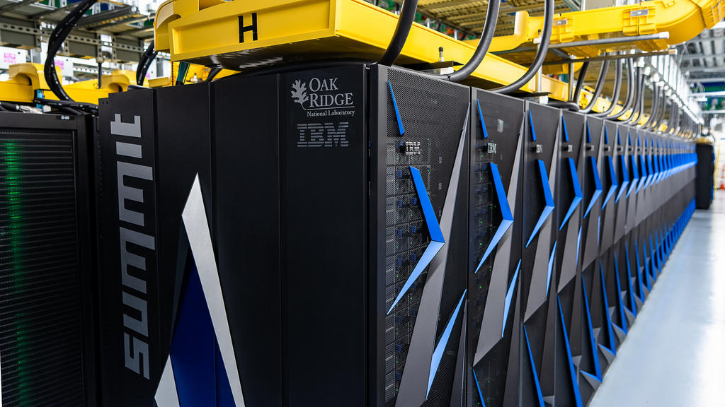
Supercomputers, example

Slide 53

Frontier, exascale AMD supercomputer, to be released 2021
1.5 Exaflops of DP arithmetic; first exascale computer
$600 million contract from Department of Energy to AMD
Built off AMD’s EPYC CPUs, each connected to four Radeon Instinct GPUs
Instinct GPU: BW – 1228 GB/s; Flops/s – 11.5 Tflops (DP); Technology - 7 nm; 300W; PCIe-4.0
Size of two basketball courts (7300 square feet)
90 miles of cables
Drawing 30 MWatts

Slide 54
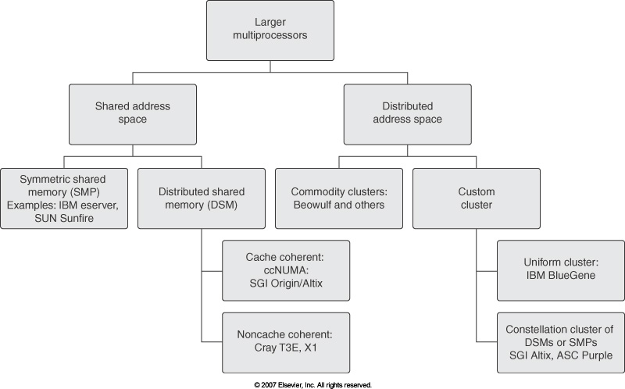
Overview of Large Multiprocessor Hardware Configurations (“supercomputers”)
Euler
Courtesy of Elsevier, Computer Architecture, Hennessey and Patterson, fourth edition
Notes:
For the Microprocessor this is measured in MIPS (million instructions per second). Many reported IPS values have represented "peak" execution rates on artificial instruction sequences with few branches, whereas realistic workloads typically lead to significantly lower IPS values.

Slide 55
Nomenclature Issues
Shared address space: when you invoke address “0x0043fc6f” on one machine and then invoke “0x0043fc6f” on a different machine they actually point to the same global memory space
Issues: memory coherence
Fix: software-based or hardware-based
Distributed address space: the opposite of the above
Symmetric Multiprocessing (SMP): you have one machine that shares amongst all its processing units a certain amount of memory (same address space)
Mechanisms should be in place to prevent data hazards (RAW, WAR, WAW). Raises the issue of memory coherence
Distributed shared memory (DSM) – aka distributed global address space (DGAS)
Although physically memory is distributed, it shows as one uniform memory
Memory latency is highly unpredictable; depends on where in memory your data is stored

Slide 56
Example
Distributed-memory multiprocessor (MP) architecture
Euler, for instance
Courtesy of Elsevier, Computer Architecture, Hennessey and Patterson, fifth edition
56
Notes:
Hammad – Updated Figure from fifth edition

Slide 57
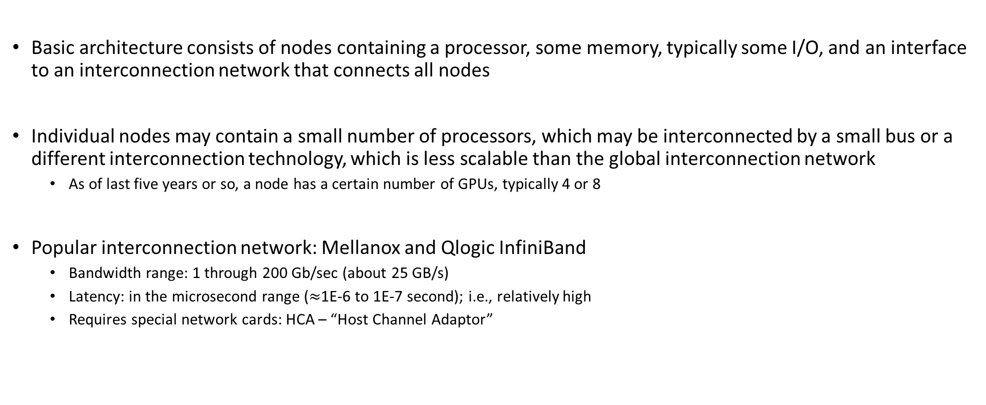
Comments, distributed-memory multiprocessor architecture
Basic architecture consists of nodes containing a processor, some memory, typically some I/O, and an interface to an interconnection network that connects all nodes
Individual nodes may contain a small number of processors, which may be interconnected by a small bus or a different interconnection technology, which is less scalable than the global interconnection network
As of last five years or so, a node has a certain number of GPUs, typically 4 or 8
Popular interconnection network: Mellanox and Qlogic InfiniBand
Bandwidth range: 1 through 200 Gb/sec (about 25 GB/s)
Latency: in the microsecond range ($≈$1E-6 to 1E-7 second); i.e., relatively high
Requires special network cards: HCA – “Host Channel Adaptor”

Slide 58
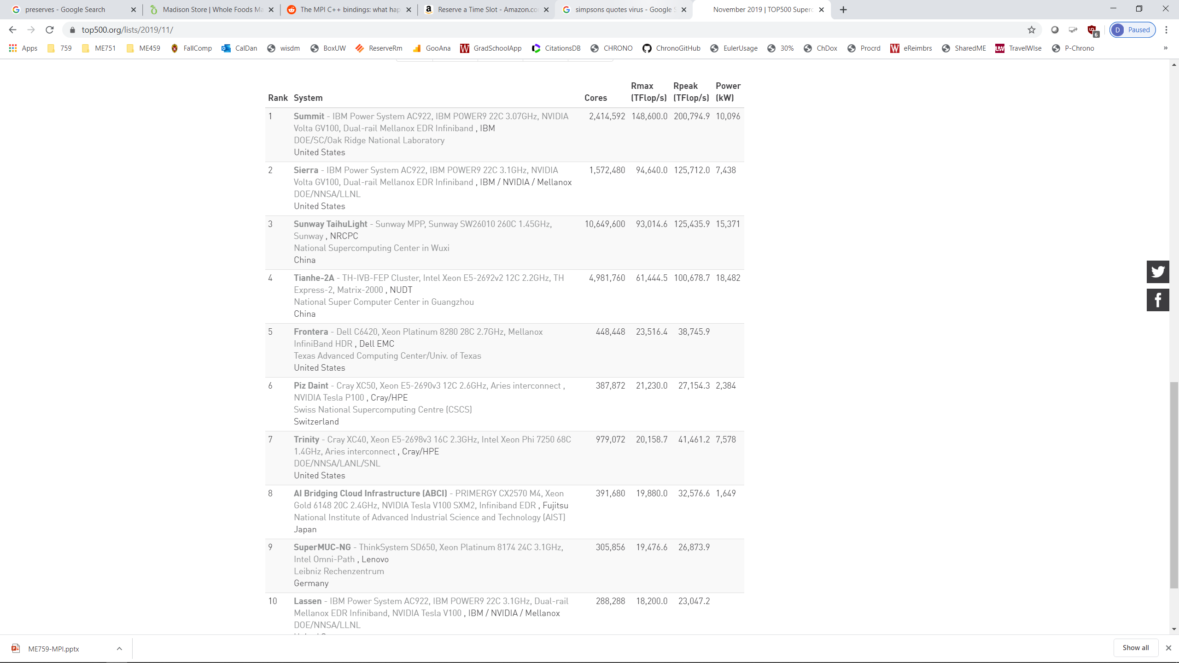
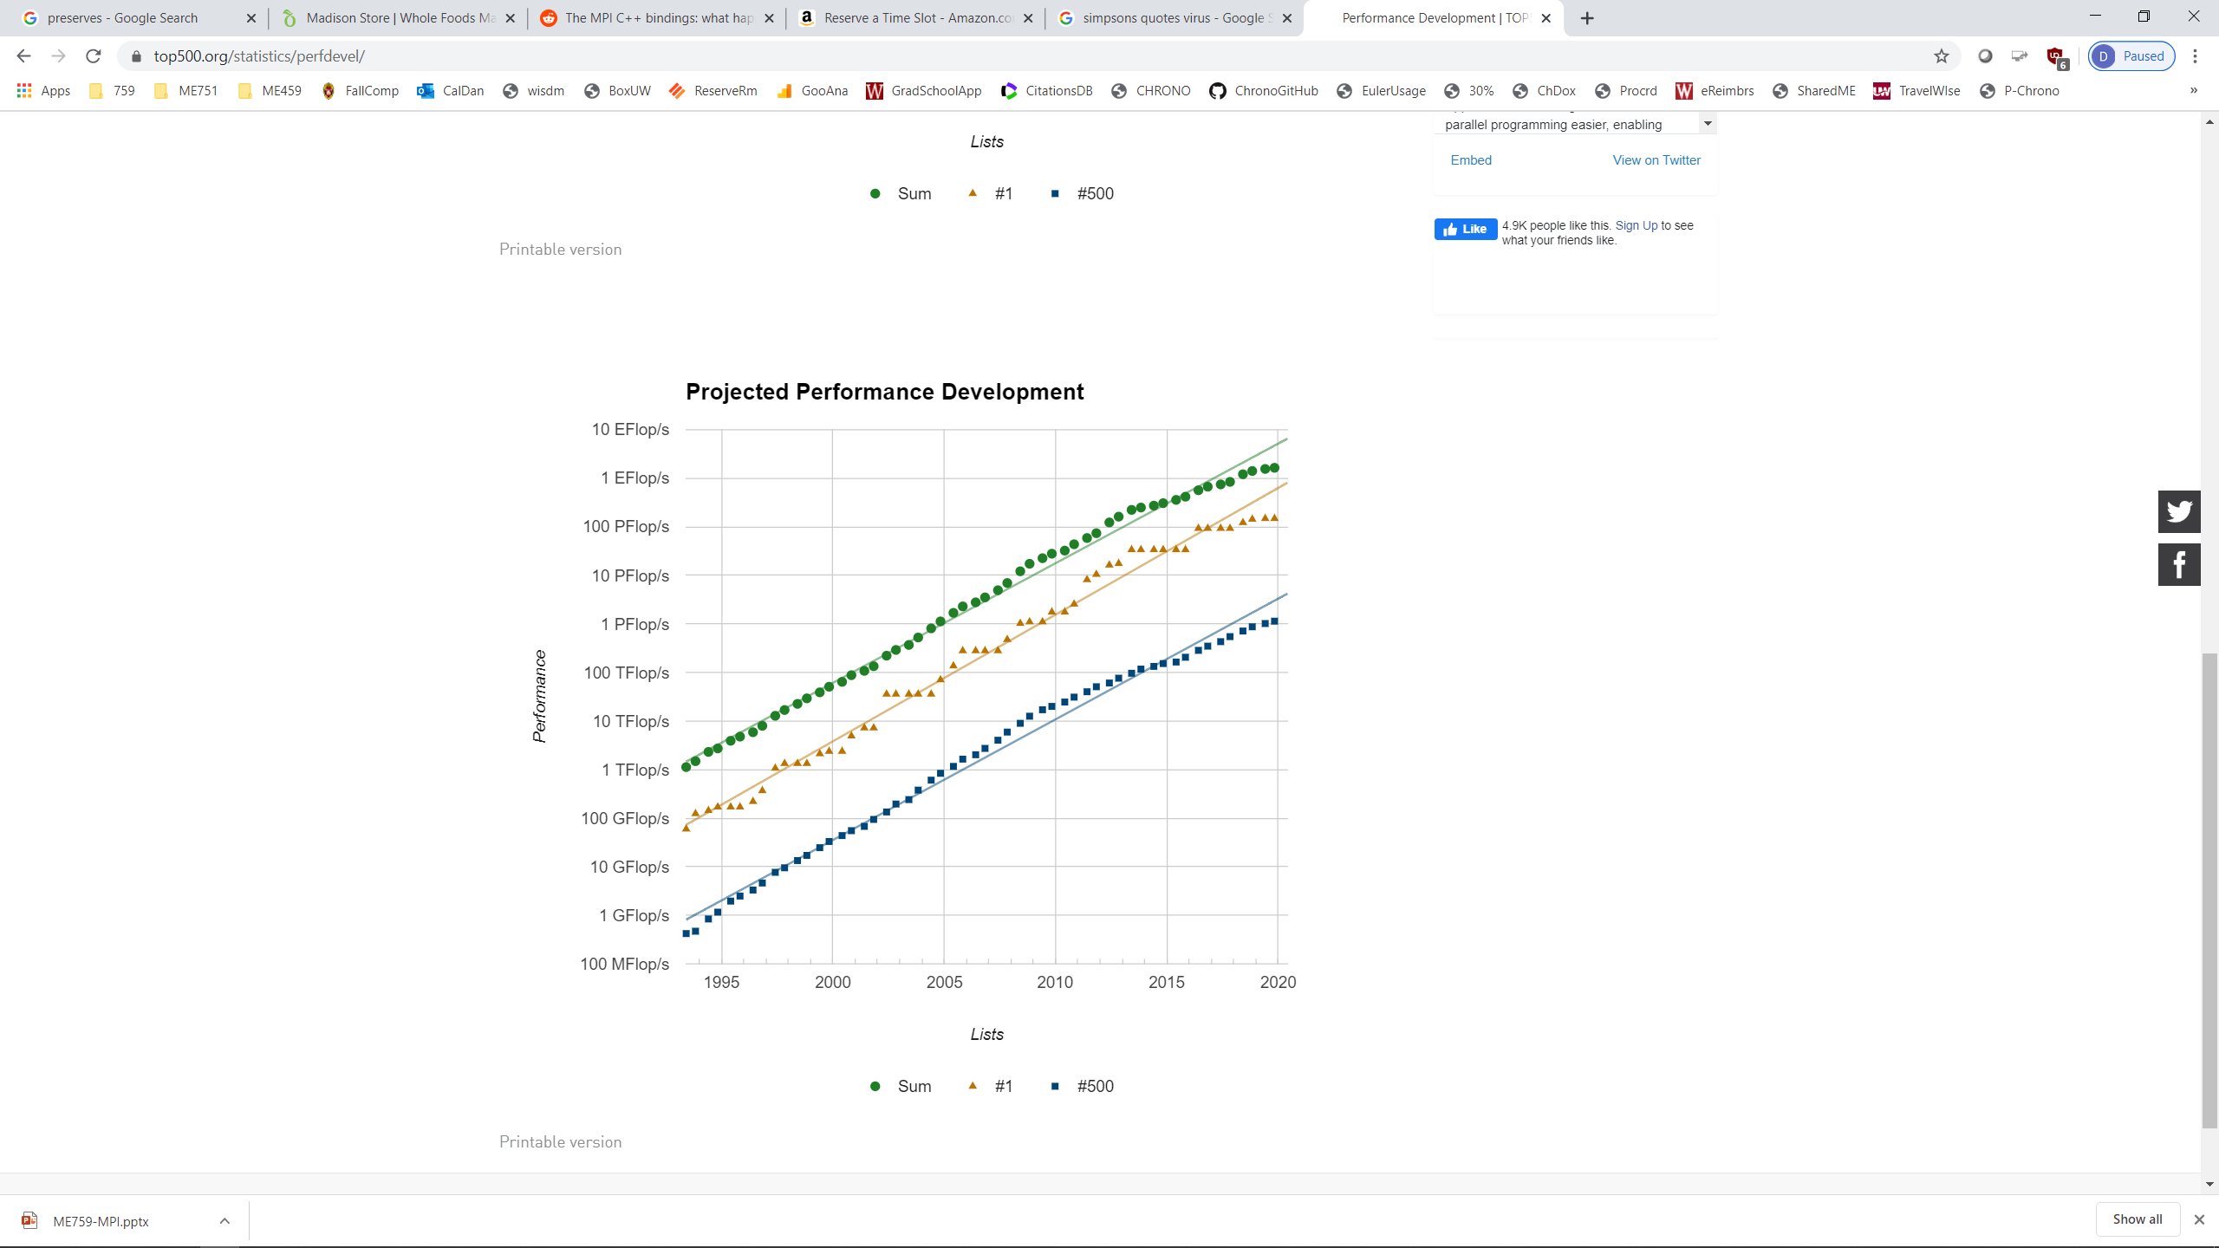
Supercomputers: Where Are We Today? [Info lifted from Top500 website: http://www.top500.org/]
Notes:
58

Slide 59

How is a supercomputer’s speed measured?
How is the speed measured to put together the Top500?
Test based on how fast you can solve a dense linear system

Slide 60
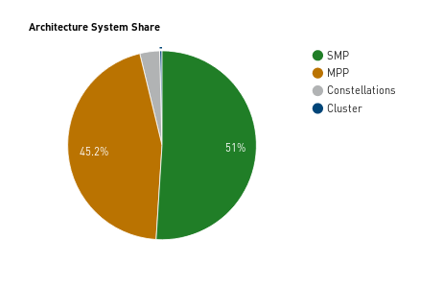
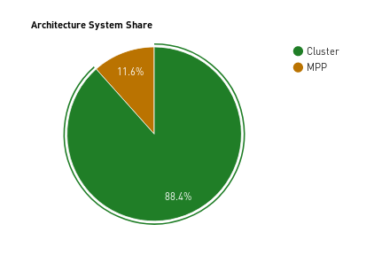
Supercomputers: What setup employed?
1998
2018
Abbreviations/Nomenclature
MPP – Massively Parallel Processing
Constellation – subclass of cluster architecture envisioned to capitalize on data locality
60
Notes:
Hammad – Updated with newer plots
60

Slide 61
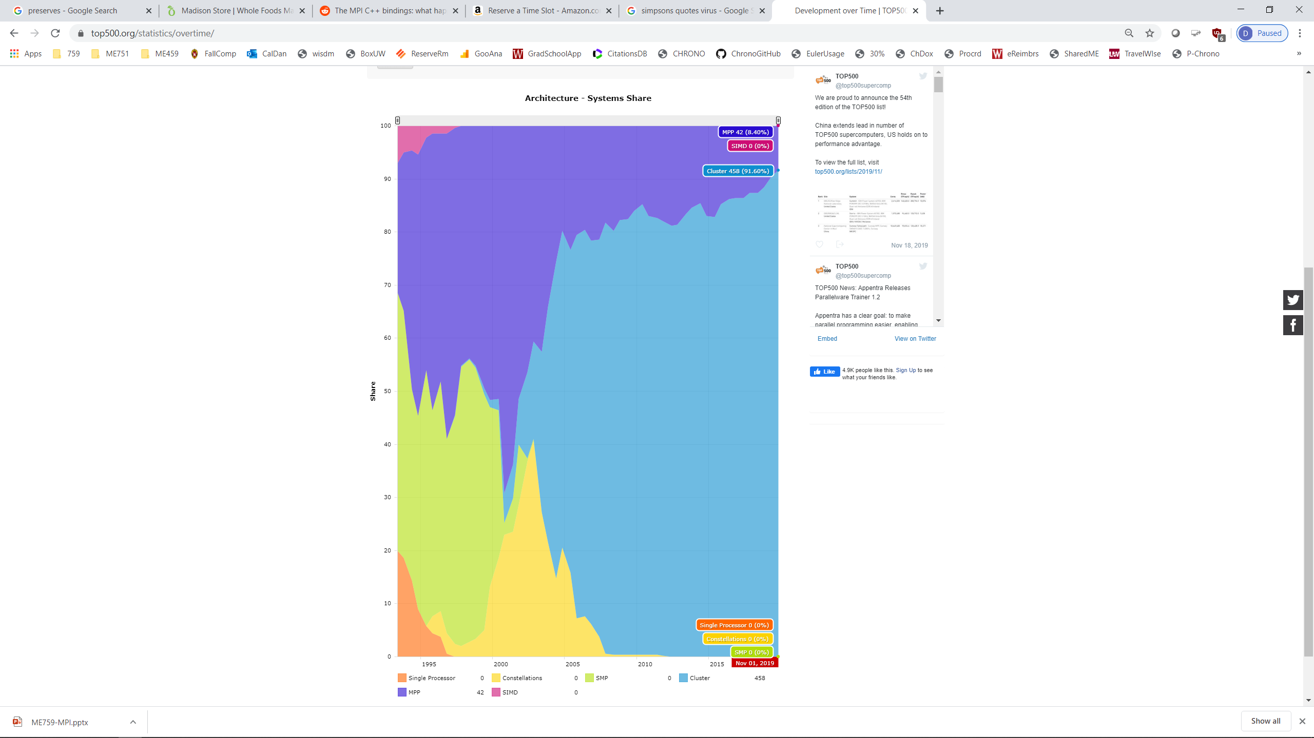
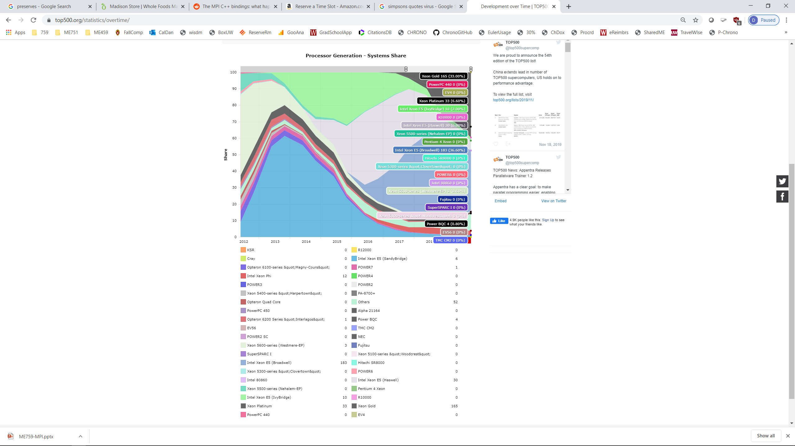
Supercomputers: Where Are We Today? [Cntd.]
Abbreviations/Nomenclature
MPP – Massively Parallel Processing
Constellation – subclass of cluster architecture envisioned to capitalize on data locality
MIPS – “Microprocessor without Interlocked Pipeline Stages”, a chip design of the MIPS Computer Systems of Sunnyvale, California
SPARC – “Scalable Processor Architecture” is a RISC instruction set architecture developed by Sun Microsystems (now Oracle) and introduced in mid-1987
Alpha - a 64-bit reduced instruction set computer (RISC) instruction set architecture developed by DEC (Digital Equipment Corporation was sold to Compaq, which was sold to HP) – adopted by Chinese chip manufacturer
Notes:
Hammad – Updated with newer plots

Slide 62
Nomenclature: What is an MPP? How’s it different from a cluster?
MPP: A very large-scale computing system with commodity processing nodes interconnected with a custom-made high-bandwidth low-latency interconnect
A cluster is an MPP for which the manufacturer forgot to put a high-bandwidth low-latency interconnect
Memories are physically distributed
Nodes often run a microkernel
Perhaps this is a second difference, a cluster might run some rather pedestrian Linux distro
Rather blurred line between MPPs and clusters
Example:
Euler (our machine) is a cluster
An IBM BG/Q machine is an MPP (because of the interconnect)

Slide 63
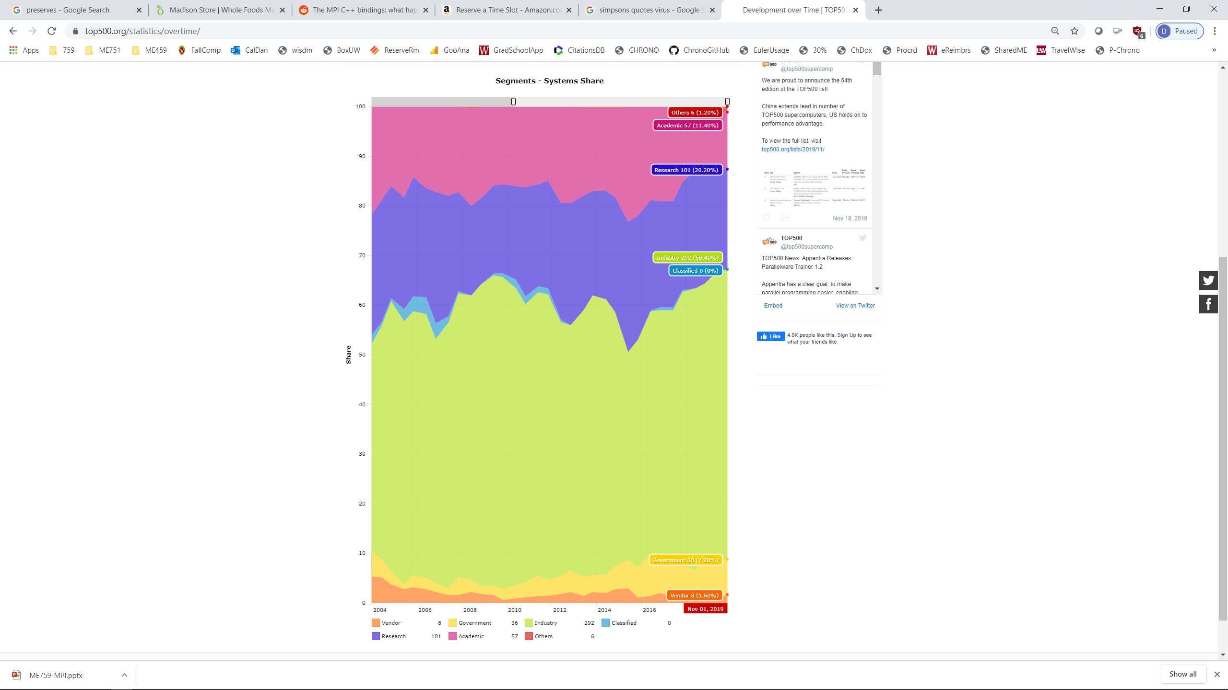
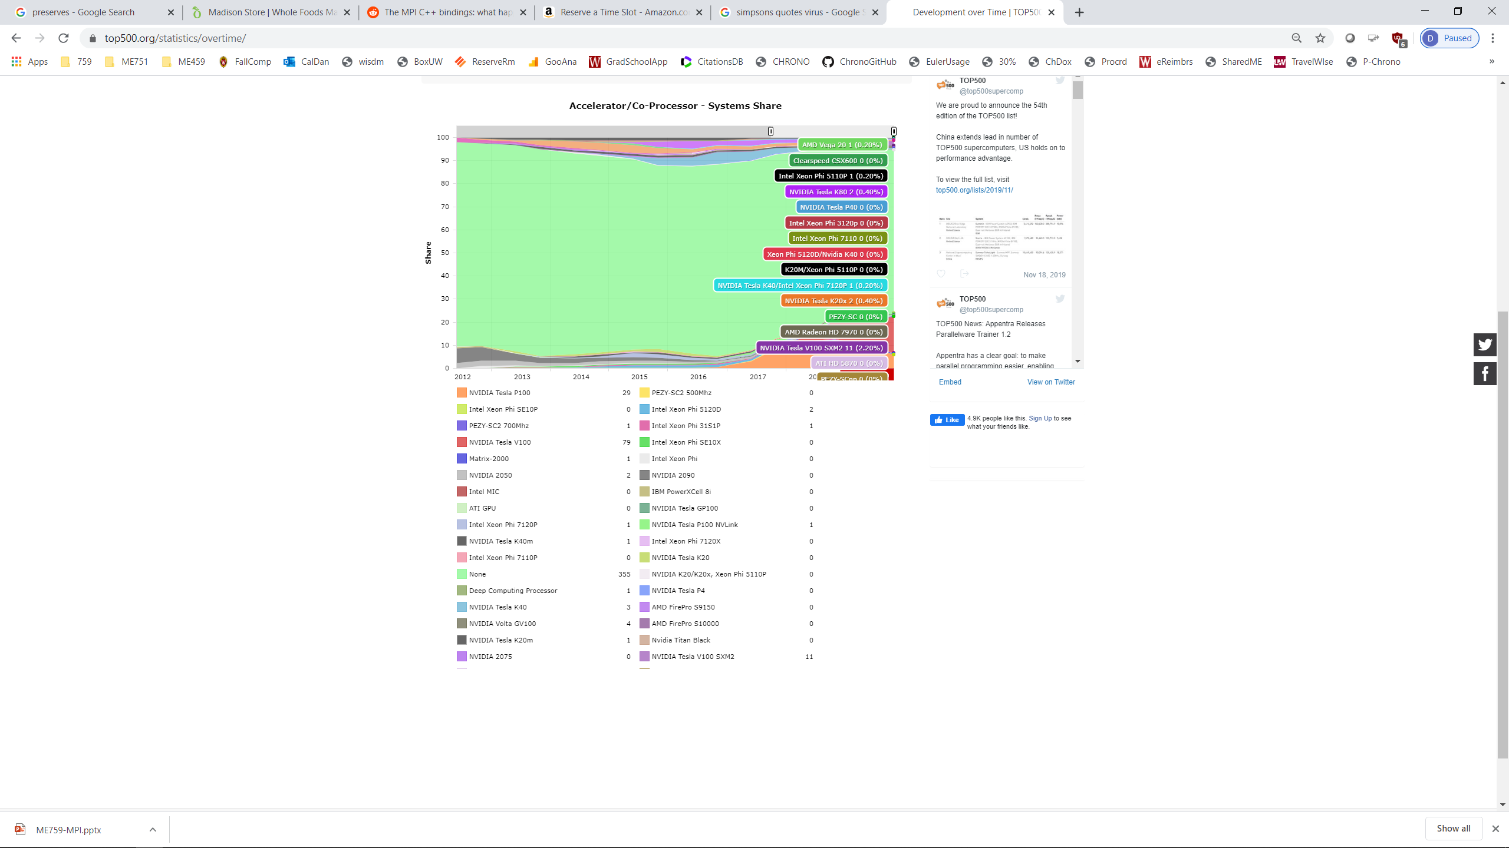
Supercomputers: Any acceleration?
Top 500: What accelerators do they use?

Slide 64
Shared Memory Hardware Systems
Memory is shared; i.e., visible to all processors and threads
Typical scenario, on a budget: one node with four CPUs, each with 16 cores
Typically one node systems; i.e., a workstation or a laptop
Example:
Symmetric Multi-Processors (SMP) – like one node of Euler
Each processor has equal access to RAM
There are custom solutions that have a software layer that makes the physically distributed memory appear to the program as one unified pool of logical memory
Popular at some point, not so much anymore

Slide 65


SMS vs. Distributed Memory Systems (DMS)
Shared Memory System
CPU
CPU
CPU
$$⋯$$
CPU
Interconnect
Memory
Distributed Memory System
CPU
CPU
CPU
CPU
$$⋯$$
Memory
Memory
Memory
Memory
Interconnect

Slide 66
Distributed Memory Hardware Systems: The Virtual Memory Angle
Typically, parallelism on supercomputers accomplished by interplay between different *processes* and not threads
Consequence: each process sees its own virtual memory, there’s no overlap
More tedious to write programs for distributed memory systems since the programmer must keep track of memory usage

Slide 67
Bandwidths in a multi-node, CPU-GPU System
NOTE: The width of the black lines is proportional to the bandwidth.
Latency:
Low
GPU cores
CPU Core
Cache
80GB/s
The typical node, connected to other nodes in a supercomputer
50-100
GB/s
900
GB/s
GPU accelerator
Latency:
Medium Low
Latency:
Pretty Low
System Memory
GPU Memory
Infiniband to Next Node
8-16 GB/s
6GB/s
Latency:
High
Latency:
Medium
This is important over the next two lectures
Notes:
67
Hammad – GPU numbers are for a Volta V100, PCI numbers are for PCIe3
Infiniband is assuming mellanox results from here: http://www.mellanox.com/page/performance_infiniband
CPU memory numbers are for a E7 8890v3 http://ark.intel.com/products/84685/Intel-Xeon-Processor-E7-8890-v3-45M-Cache-2_50-GHz
CPU cache numbers are an average between expected L1 and L3 cache performance (not exact but approximate)

Slide 68
A “High Performance Computing” Digression
High Performance Computing, to an expert, has a very precise meaning: supercomputing
HPC entails the idea of a bunch of nodes linked through fast interconnect trying to solve together one big problem
This class “759: High Performance Computing for Applications in Engineering”
High performance computing: you compute at the bounds (bandwidth bound or compute bound)
The terms in blue and red: same syntax, different semantics
A way of computing vs. an attribute of a program

Slide 69
High Performance Computing (HPC) vs. High Throughput Computing (HTC)
High Performance Computing
The idea: run one executable as fast as you can
Might spend one month running one DFT job or a week on a CFD job…
High Throughput Computing
The idea: run many executables at the same time on different machines
Example: bone analysis in ABAQUS
You have uncertainty in the length of the bone (20 possible lengths) in the material of the bone (10 values for Young’s modulus) in the loading of the bone (50 force values with different magnitude/direction) . Grand total: 10,000 ABAQUS runs
We have 1400 workstations hooked up together on-campus -> use Condor to schedule the 10,000 independent ABAQUS jobs and have them run on scattered machines overnight

Slide 70
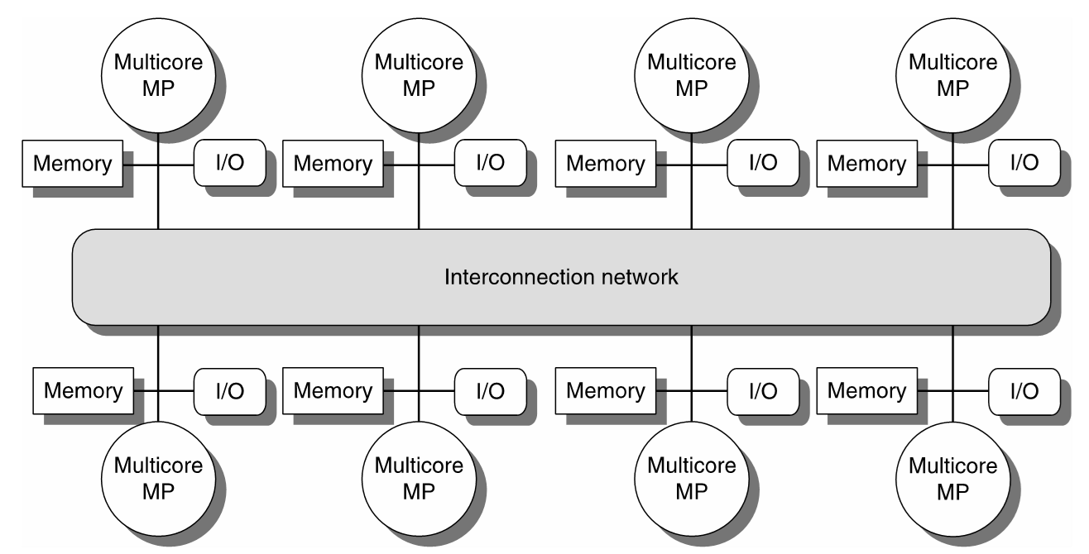
High Performance Computing (HPC) vs. High Throughput Computing (HTC)
High Performance Computing
Usually one cluster (e.g. Euler) or one massively parallel machine (e.g. IBM Blue Gene or Cray) that is dedicated to running one large application that requires a lot of memory, a lot of compute power, and a lot of communication
Example: each particle in a MD simulation requires (due to long range electrostatic interaction) to keep track of a large number of particles that it interacts with. Needs to query and figure out where these other particles are at any time step of the numerical integration
What is crucial is the interconnect between the processing units
Typically some fast dedicated interconnect (e.g. InfiniBand), which operates at 40 GB/s
Euclid@UW-Madison: 1 GB/s Ethernet, Bluewaters@UIU/C: 100 GB/s, Tianhe-I claims double the speed of Infiniband
Typically uniform hardware components: e.g. 100,000 Intel Xeon 5520, etc.
Expensive
HPC: this interconnect expected to be fast…

Slide 71
High Performance Computing (HPC) vs. High Throughput Computing (HTC)
High Throughput Computing
Usually a collection of heterogeneous compute resources linked through a slow connection, most likely Ethernet
Example: 120 Windows workstations in the CAE labs (all sorts of machines, some new, some old)
When CAE machine 58 runs an ABAQUS bone simulation there is no communication needed with CAE machine 83 that runs a different ABAQUS scenario
Don’t need to spend any money, you can piggyback on resources willing to make themselves available
Very effective to run Design of Experiments type analyses
Any two nodes might have very
different setups/assets
This interconnect
might be slow

Slide 72
High Performance Computing (HPC) vs. High Throughput Computing (HTC)
You can do HPC on a configuration that has slow interconnect
It will run very, very slow…
Conversely, you can do HTC on an IBM Blue Gene
You will use the processors but will waste the fast interconnect that made the machine expensive in the first place
You need to have the right licensing system in place to “check out” 10,000 ABAQUS licenses
University of Wisconsin-Madison well known due to pioneering work in the area of HTC
Professor Miron Livny in CS
UW-Madison solution for HTC: Condor, used by a broad spectrum of organizations from academia and industry

